Slide 1
Figure out What restaurants are worth going based on Foursquare user feedback

Slide 2
About the location The city of Hoboken, NJ is relatively small at ~1 square mile but it is packed with restaurants, night life and amazing people. For people that are new to Hoboken, despite its small geographic size, it can be daunting to figure out what restaurants are worth going to and where they are. For people that used to live in Hoboken or are visiting Hoboken, how do you know what the best places are to get something to eat?

Slide 3
Project Objective Create a simple guide on where to eat based on Foursquare likes, restaurant category and geographic location data for restaurants in Hoboken

Slide 4
Data Requirement ​ Using the Foursquare API to pull the following location data on restaurants in Hoboken, NJ:
Venue Name Venue ID Venue Location Venue Category Rating Price Count of Likes Phrases

Slide 5
Data Usage Approach – Clustering
Using the data acquired from Foursquare create a k-means clustering algorithm that groups restaurants into 4-5 clusters so that people looking to eat in Hoboken can easily identify restaurants will cater to what their needs

Slide 6
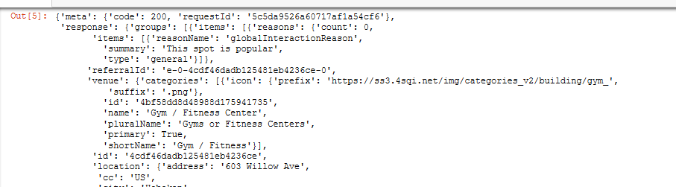
Data Acquisition Approach
Get geolocator latitude and long coordinates for Hoboken, NJ
Use Foursquare API to get a list of all venues in Hoboken
Creating a URL for all the venues in Hoboken
Pulling the JSON for the URL of venues.

Slide 7
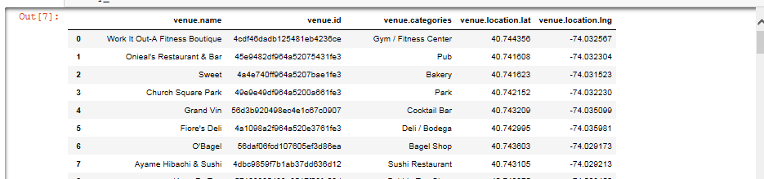
Data Acquisition Approach
Pulling the data from Foursquare into a data frame so we can manipulate and use it.
Now let's get a list of venue ids so we can pull likes and add to our data frame.
Get venue name, venue ID, location, category, and likes

Slide 8
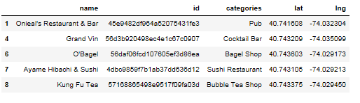
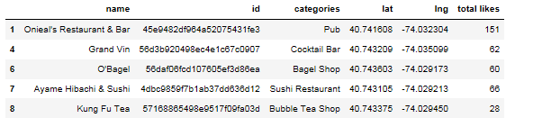
Data Preparation
Prepping our data for clustering. This will include combining data from different lists, creating new categorical data to be used, binning data and then encoding the data for clustering.
Combine our list of likes into our data frame

Slide 9
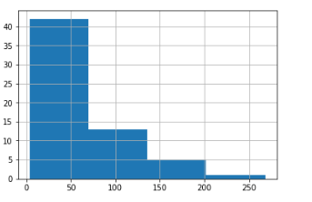
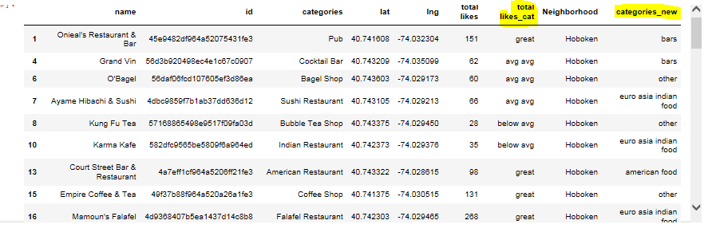
Data Preparation
Let's look at our like data to set bins and based on number of likes set them to appropriate values (see below like histogram) Visualize our total likes based on a histogram
categorize our restaurants based on likes and grouping based on type of restaurants

Slide 10
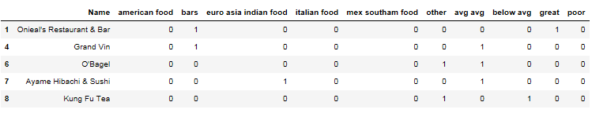
Data Preparation
Create dummy variables for total likes and categories so we can cluster
Algorithm
I will take the gathered data (see above in Data Acquisition Approach and Data Required sections) and will create a k-means clustering algorithm that groups restaurants into 4-5 clusters so that people looking to eat in Hoboken can easily see which restaurants are the best to eat at, what cuisine is available and where in Hoboken they can look to eat

Slide 11
Project Outcome then cluster these restaurants based on their similarities so that a user can easily determine what type of restaurants are best to eat at based on Foursquare user feedback

Slide 12
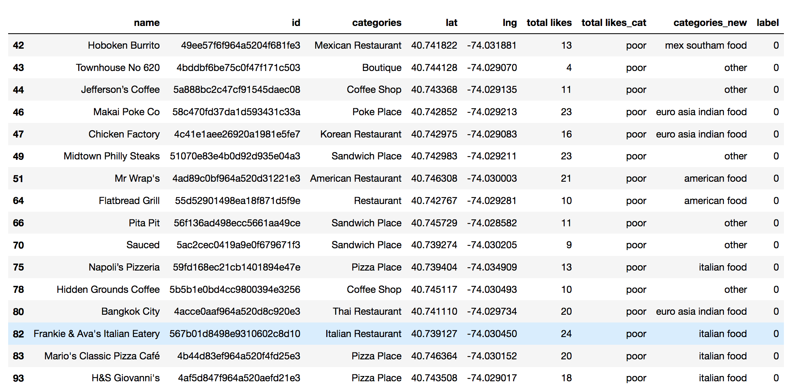
Findings : Outcome
Cluster 1
Characteristics
Poor quality food
Mostly Italian food or other

Slide 13
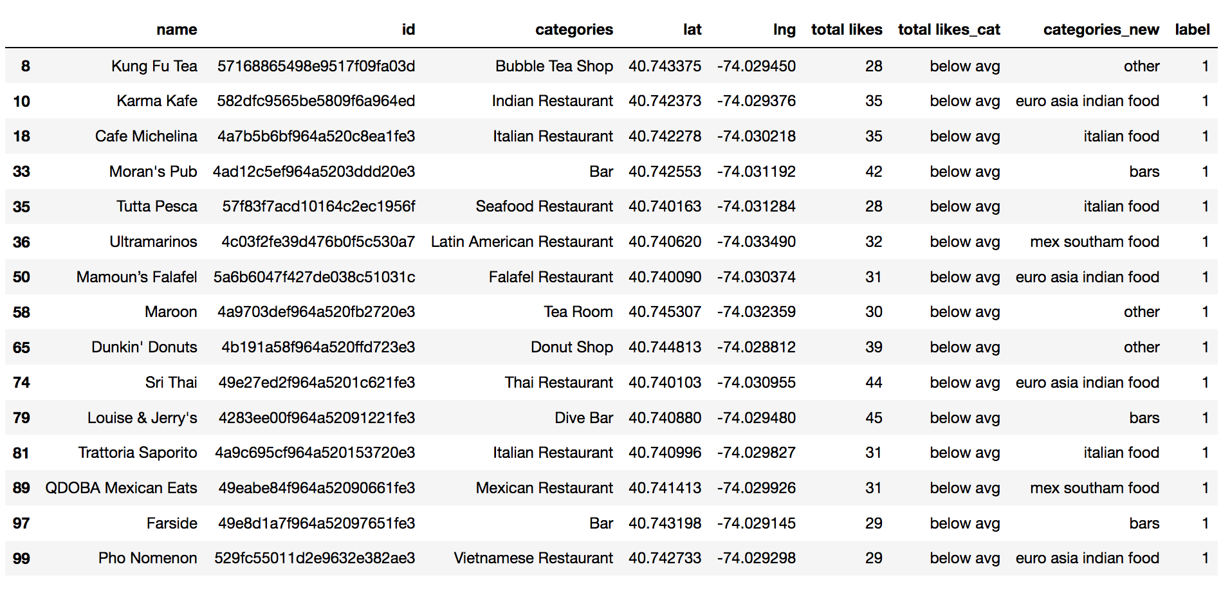
Findings : Outcome
Cluster 2
Characteristics
Below average quality food
Mostly Europe / Asia inspired food

Slide 14
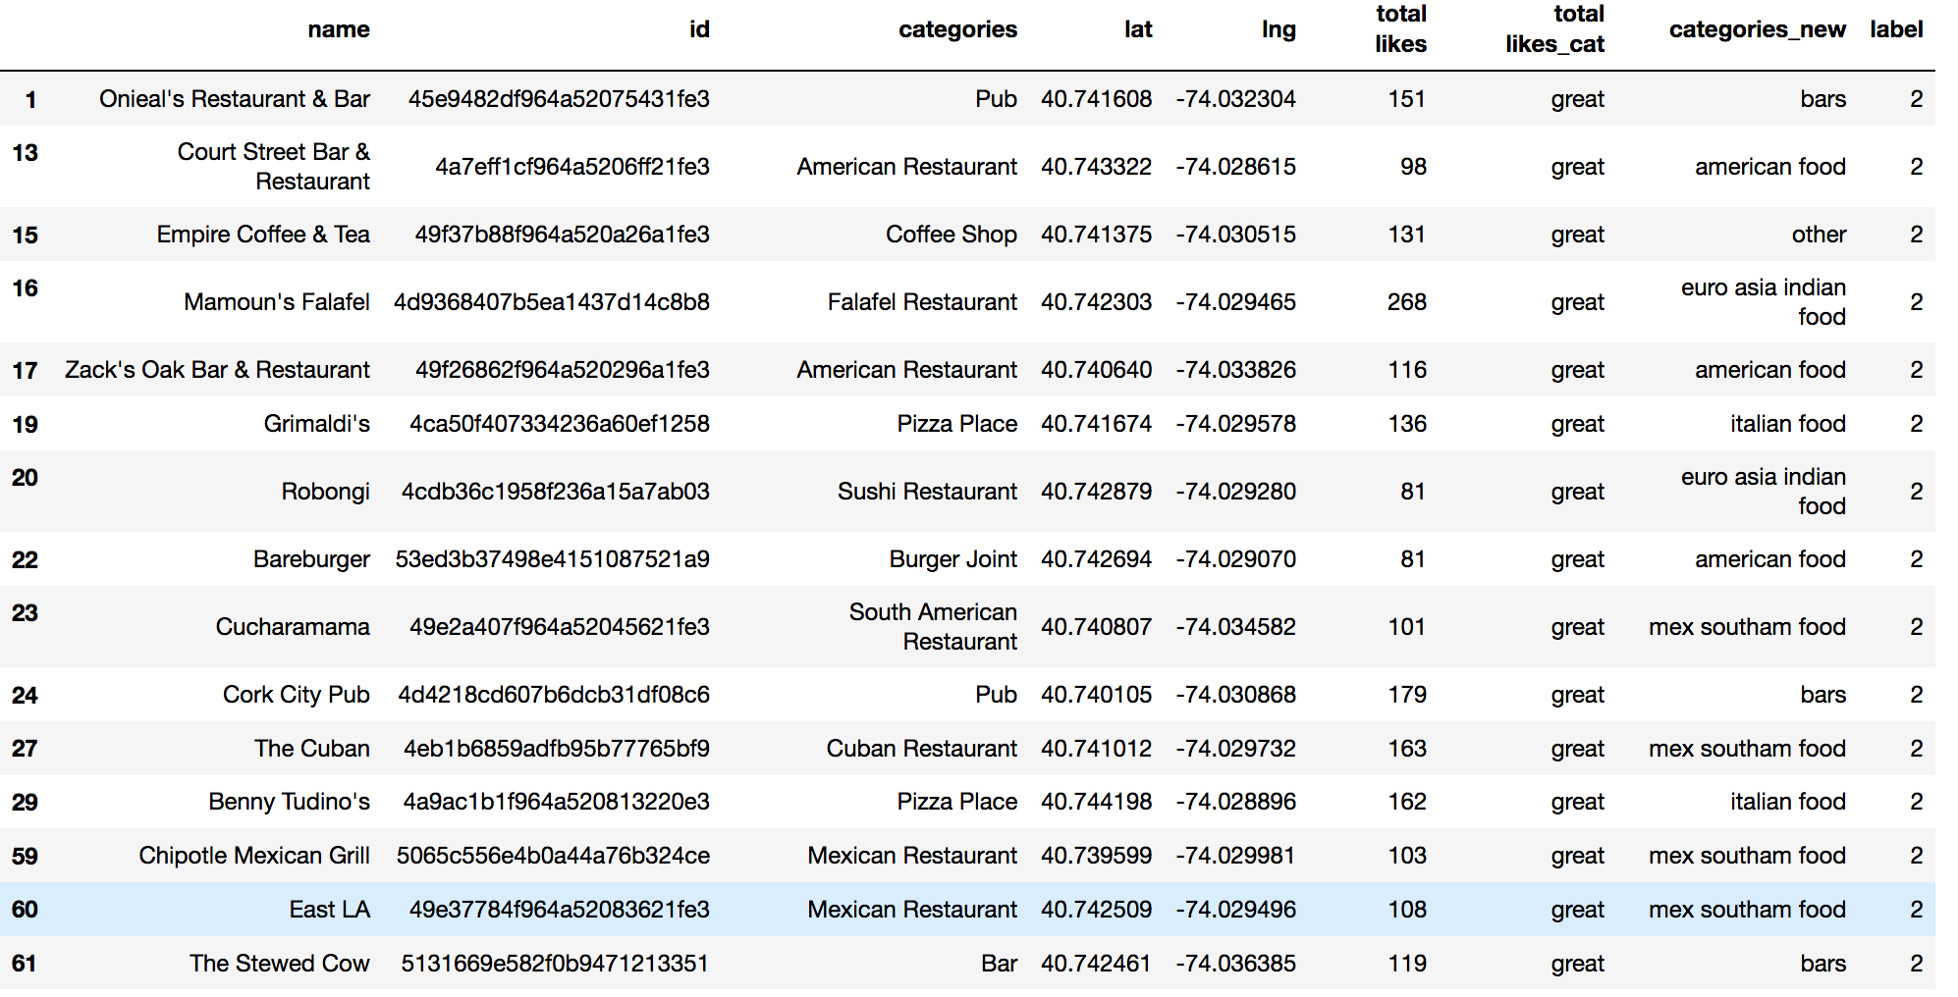
Findings : Outcome
Cluster 3
Characteristics
High quality food
Mostly Mexican and South American inspired food

Slide 15
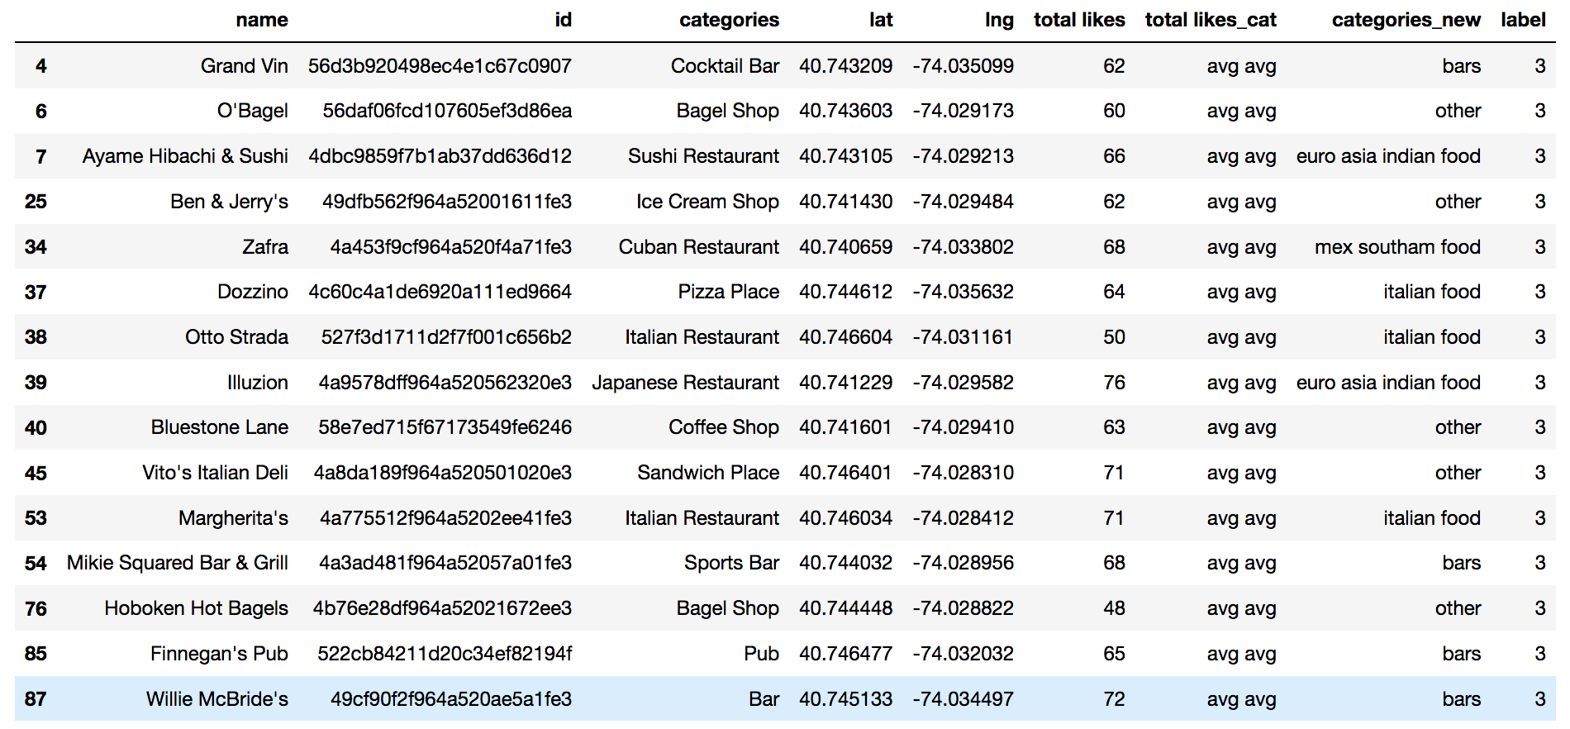
Findings : Outcome – 4 clusters with below characteristics
Cluster 4
Characteristics
Above average quality food
Mostly Bars

Slide 16
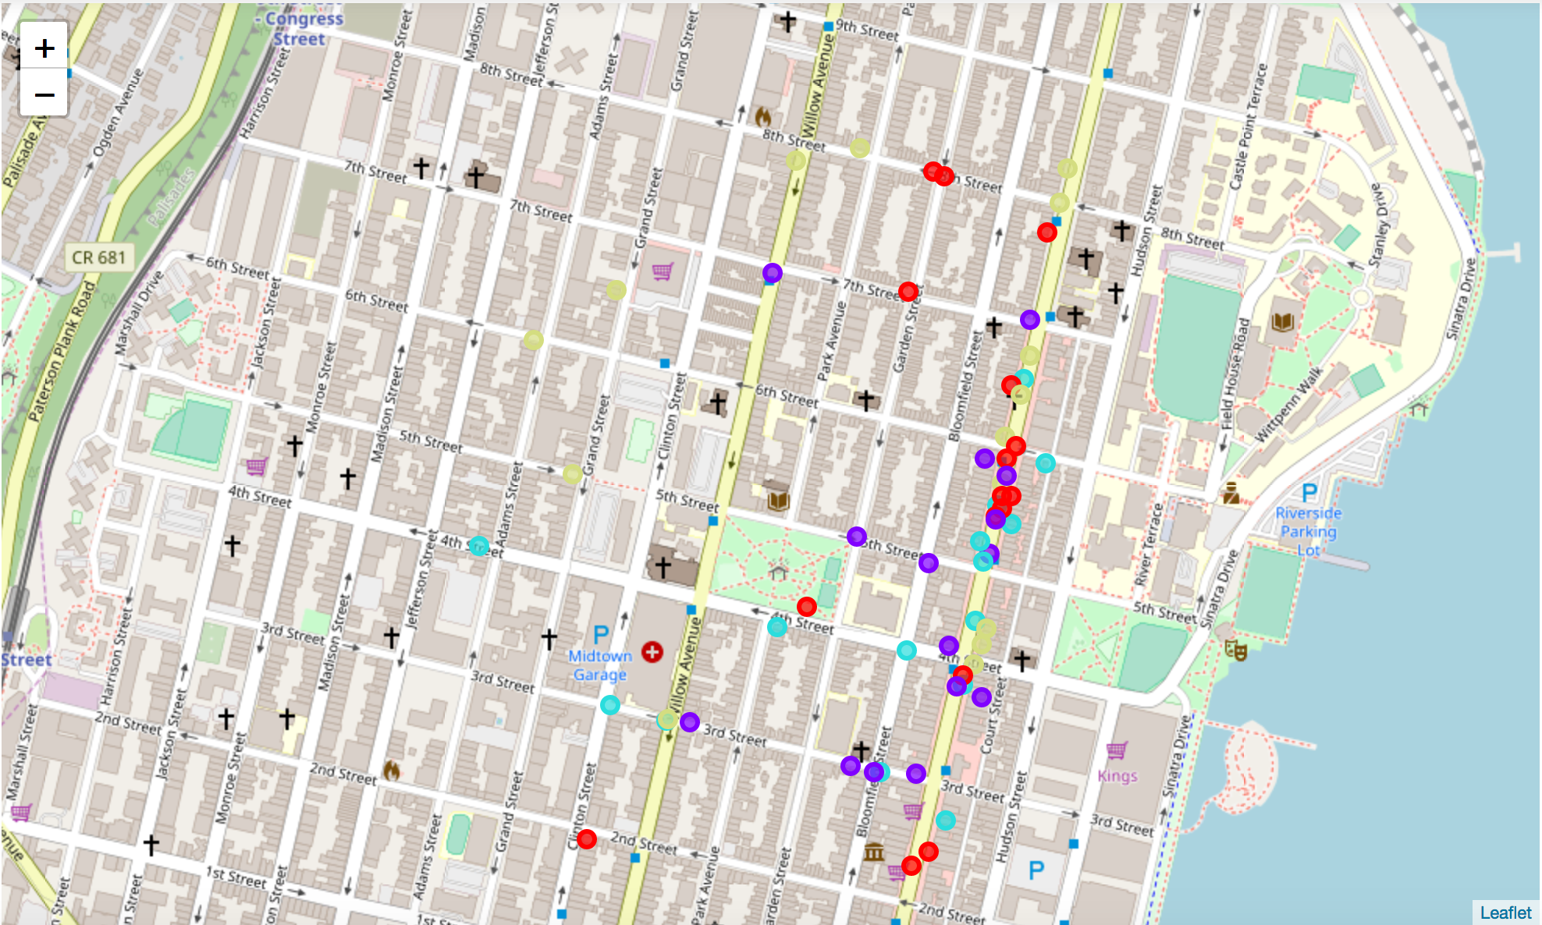
Findings : Outcome : Map

